Slide 1
CSS Grids
The CSS Grid Layout Module offers a grid-based layout system, with rows and columns, making it easier to design web pages without having to use floats and positioning.
CSS Grid Layout excels at dividing a page into major regions or defining the relationship in terms of size, position, and layer, between parts of a control built from HTML primitives. Like tables, grid layout enables an author to align elements into columns and rows.
Grids not only provide designers a structure on which to base layouts, but they also improve readability and scannability for end users. Use a good grid system that easily adapts to various screen sizes.

Slide 2
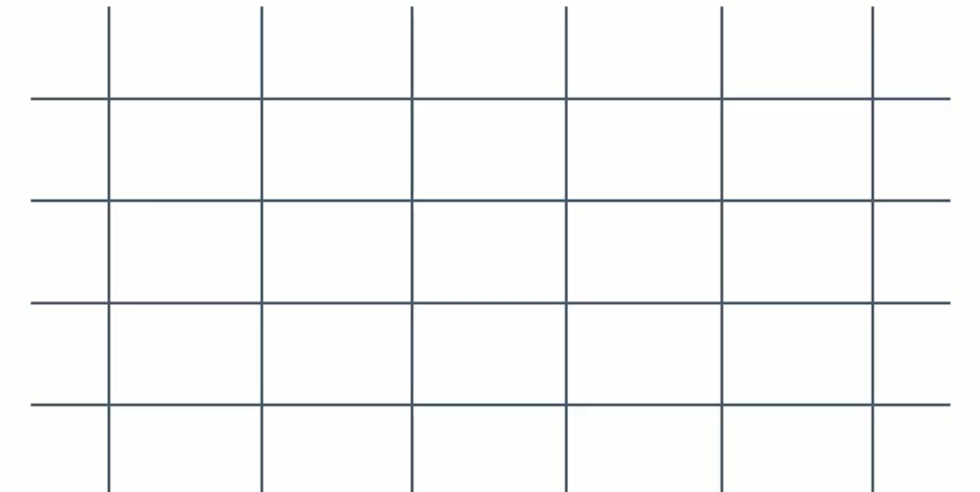
CSS Grids
The CSS Grid are two dimensional design Layout that are responsive and compatible with the price of variations.
They are alternative to an other options which is flexboxes and tables especially when you are working with the larger scale layouts.

Slide 3
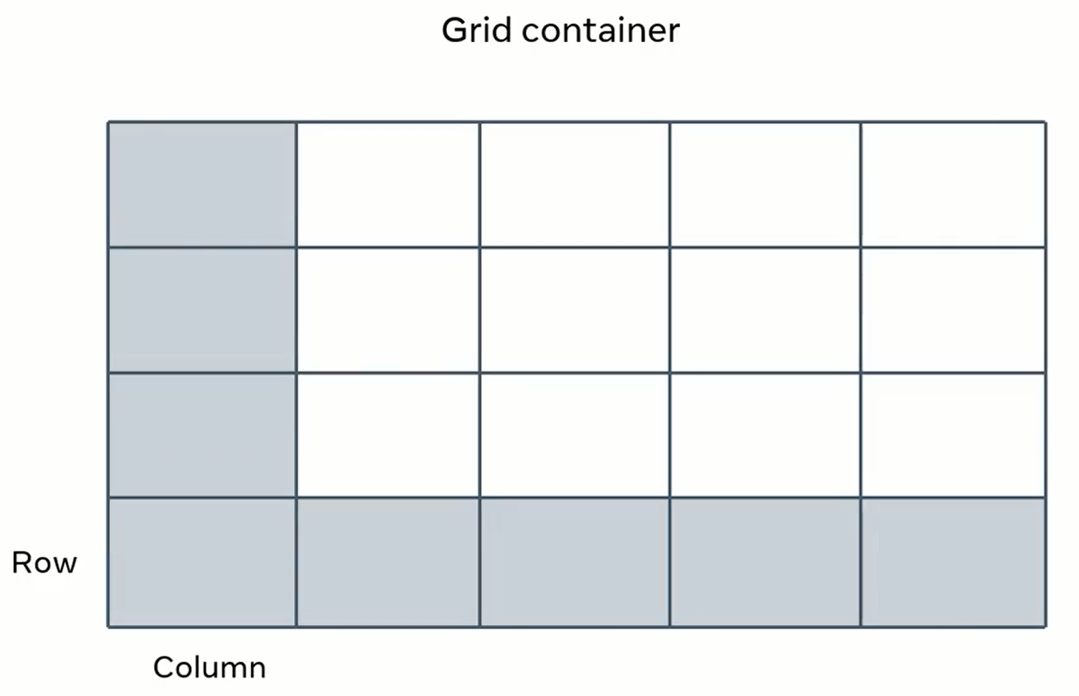

Slide 4
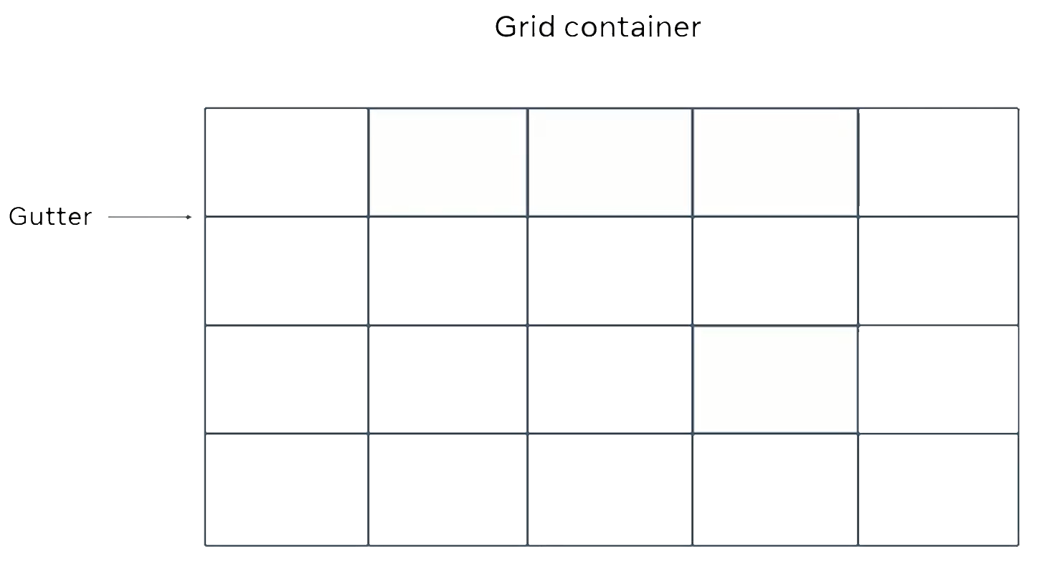
The space between the row and column is called gutter.

Slide 5
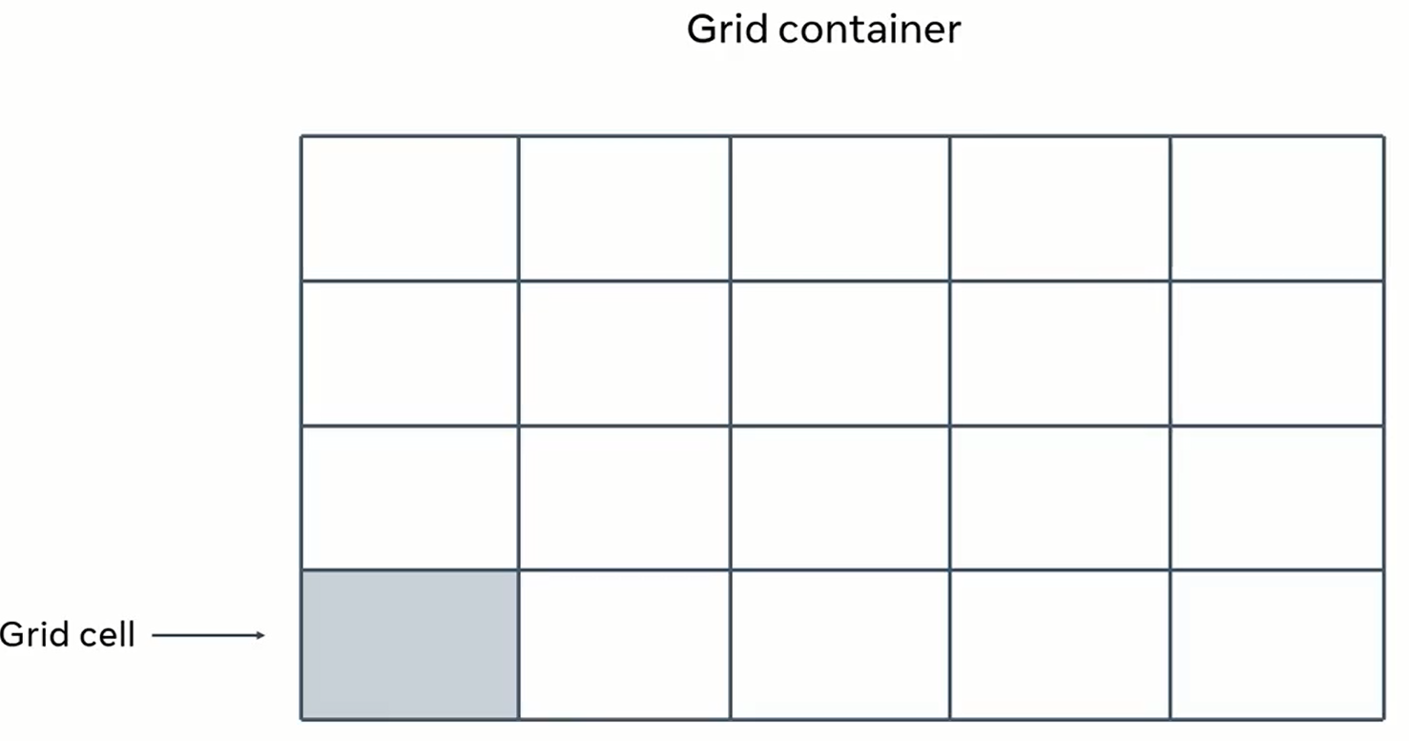

Slide 6
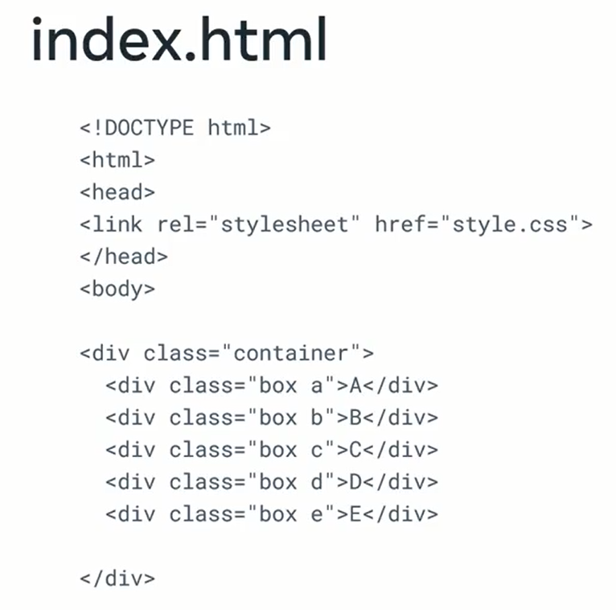
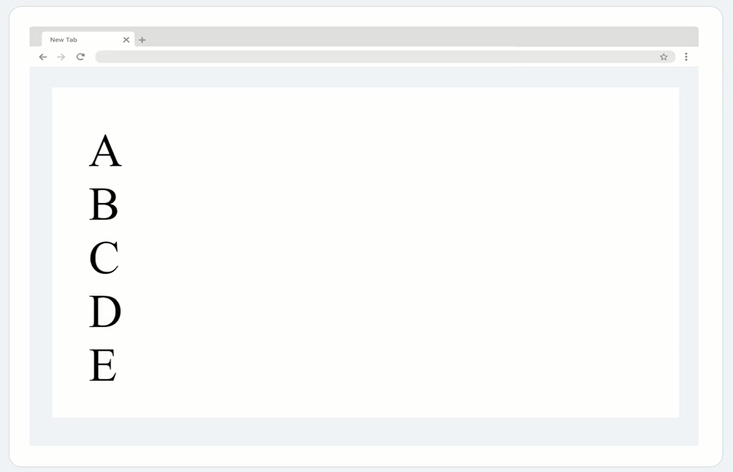

Slide 7
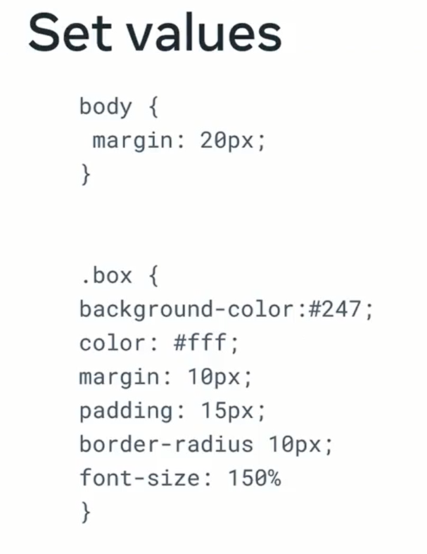
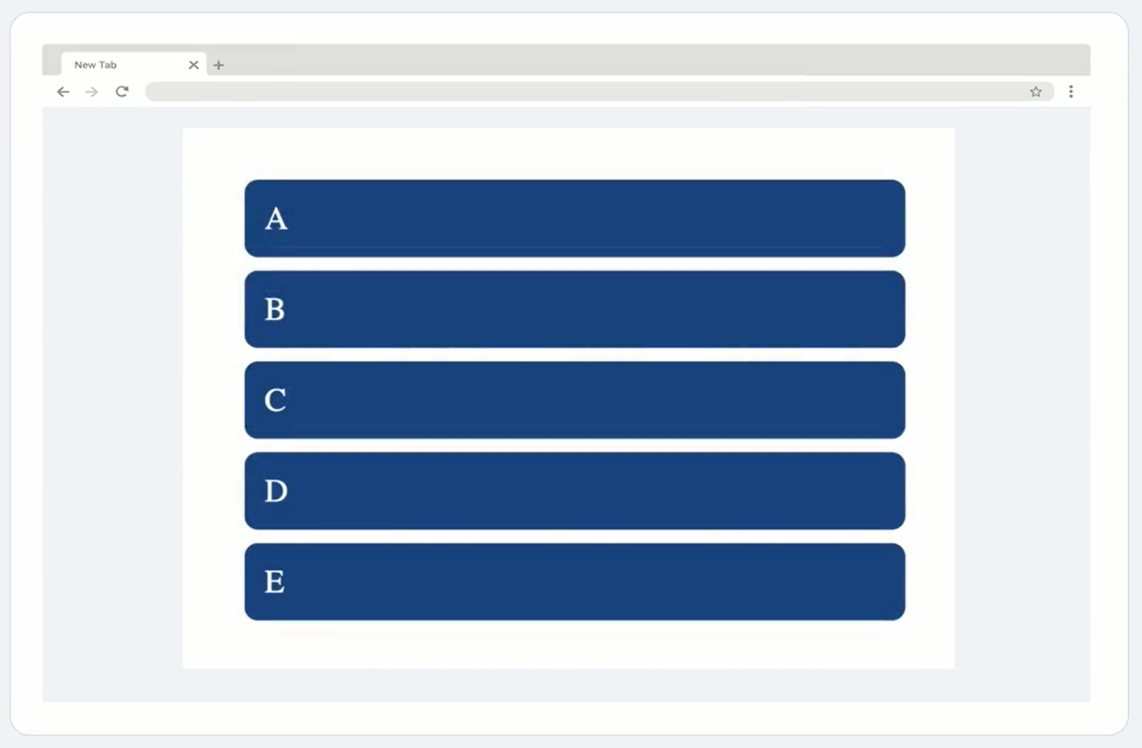
After Adding some simple CSS

Slide 8
Assign the grid value to display property
. Container {
Display: grid ;
}
The display property is also used to set the display types for other design such as flex, block, inline and it is usually the part of the container in the element

Slide 9
Update container
. Container {
Display: grid ;
grid-template-columns: 100px 100px 100px; //Divide the column through pixels
grid-template-rows:2fr 1fr; //Fraction effectively divides the grid
}

Slide 10
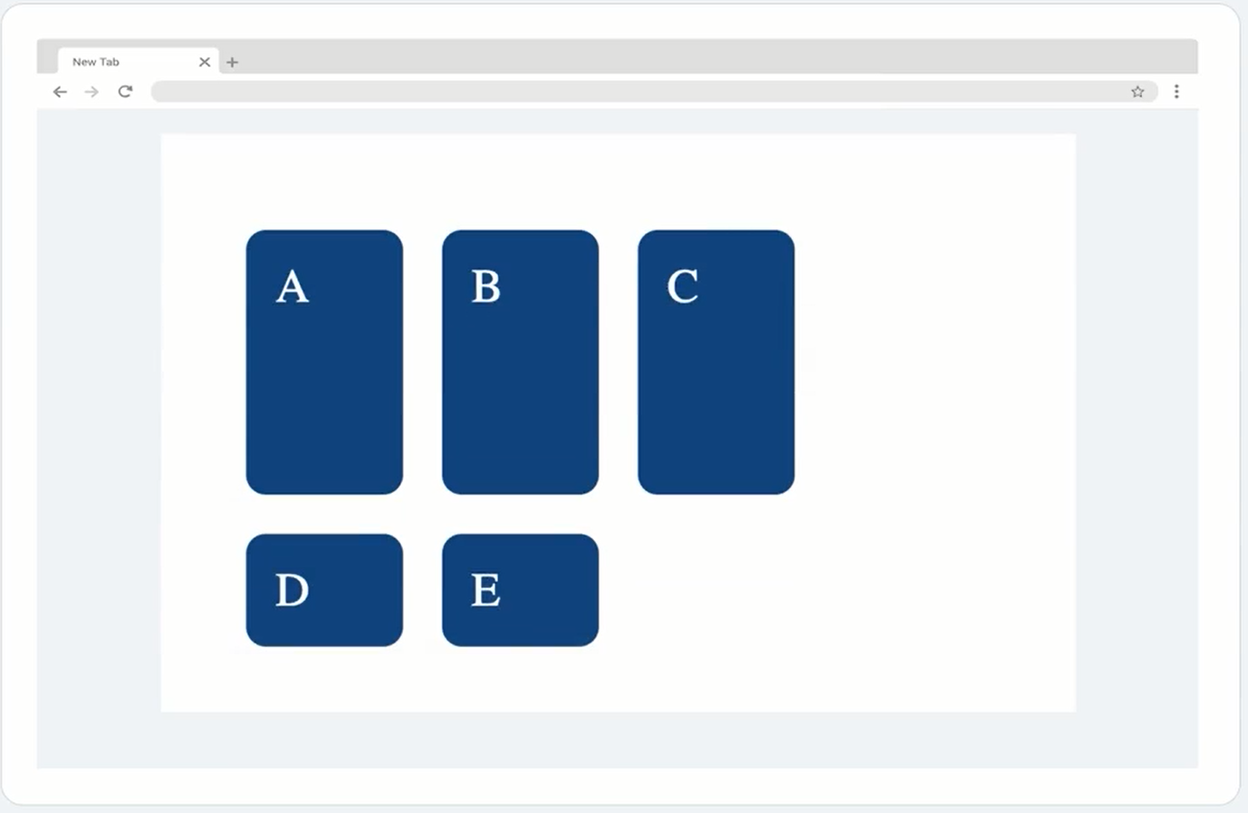
After styling through Grids CSS

Slide 11
Grid gap and background colors
. Container {
Display: grid ;
grid-template-columns: 100px 100px 100px;
grid-template-rows:2fr 1fr;
grid-gap:10px;
background-color: rgb(202,96,96);
}

Slide 12
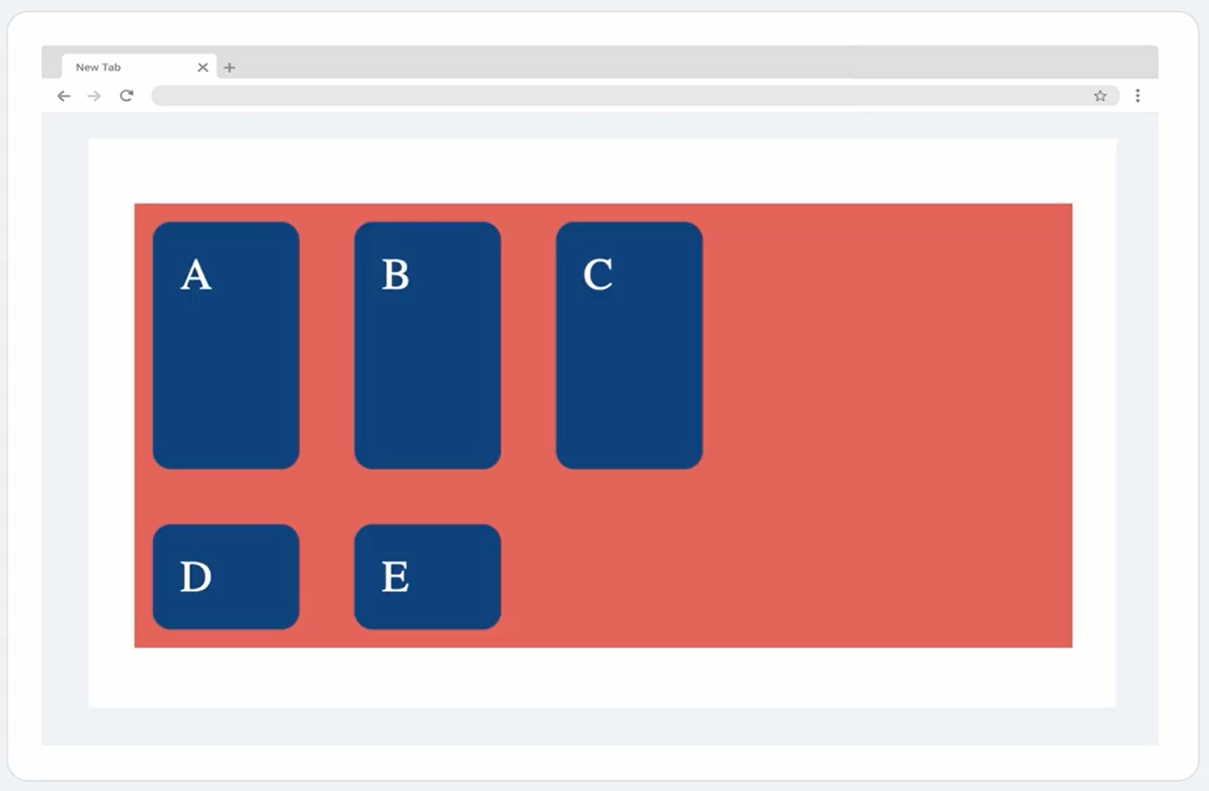

Slide 13
Grid auto rows
. Container {
Display: grid ;
grid-template-columns: 100px 100px 100px;
grid-template-rows:2fr 1fr;
grid-gap:10px;
background-color: rgb(202,96,96);
grid-auto-rows: 100px;
}

Slide 14
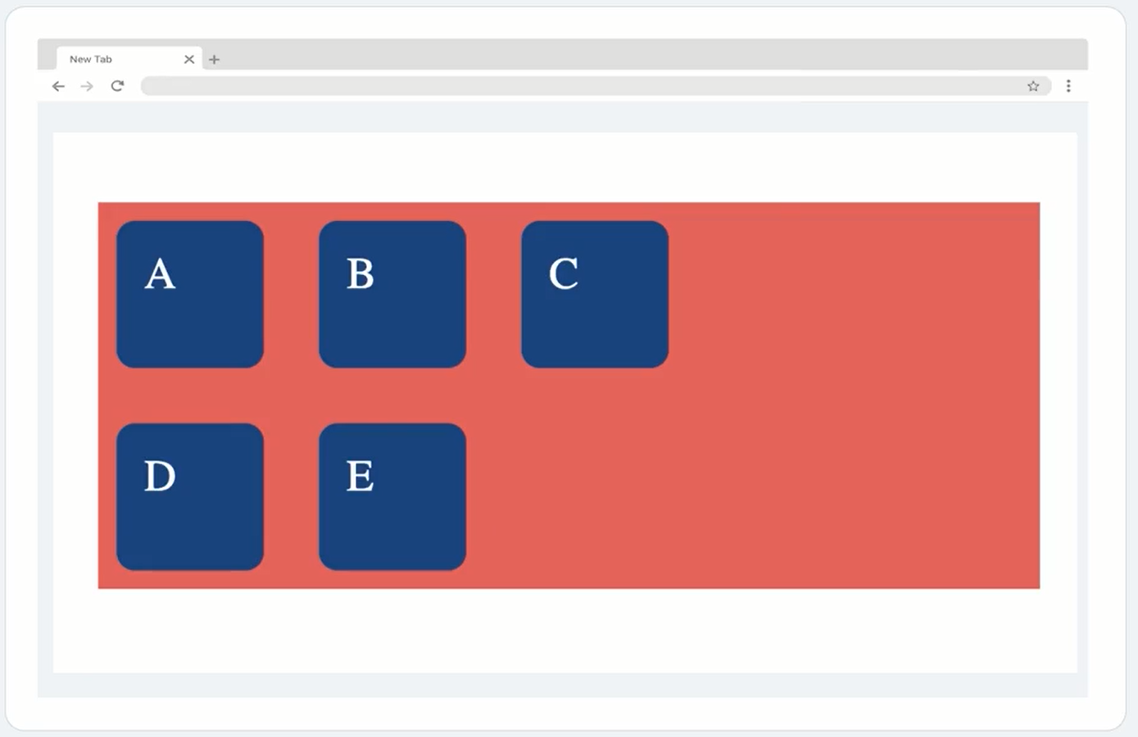

Slide 15
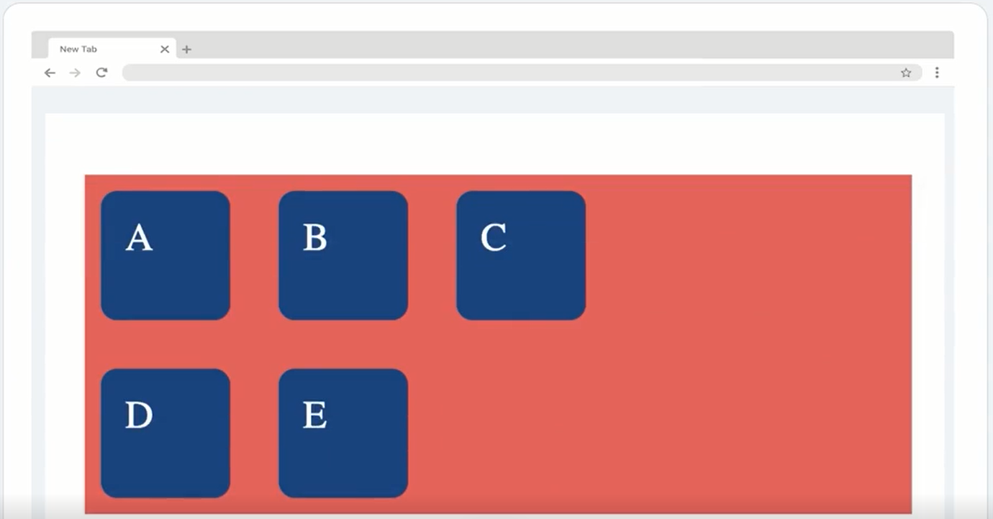
Functions
Repeat functions
The repeat function passes the number of repeats required for the number of rows and columns.
.Container {
Display: grid ;
grid-template-columns: repeat(3, 100px);
grid-template-rows:2fr 1fr;
grid-gap:10px;
background-color: rgb(202,96,96);
grid-auto-rows: 100px;
}

Slide 16
Functions
Repeat functions
The repeat function does not change anthing it just reduce the amount of the code you need to write
There for the repeat function help to reduce the redundancy on the wide range of modifications.

Slide 17
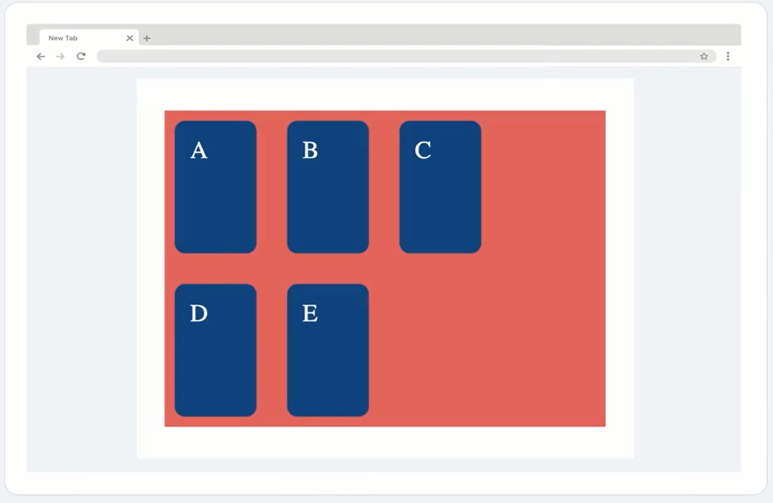
Functions
Minmax functions
The minmax function set the minimum and maximum value expected for the size of rows and columns.
.Container {
Display: grid ;
grid-template-columns: repeat(3, 100px);
grid-template-rows: minmax(150px,auto);
grid-gap:10px;
background-color: rgb(202,96,96);
grid-auto-rows: 100px;
}

